Slide 1
Edge Enhancement Diffusion

Slide 2
Motivation:
A frequent problem in low-level vision consists of eliminating noise and small-scale details from an image while still preserving or even enhancing the edge structure. Nonlinear anisotropic diffusion filtering may be one possibility to achieve these goals.

Slide 3
Introduction
In many practical applications, the nonlinear diffusion technique due to Perona and Malik is used. This method is well-known to give poor results for very noisy images. But also more robust regularizations may still lead to problems at noisy edges, as long as they use scalar-valued diffusivities.
It is demonstrated that our model which uses an adapted diffusion tensor instead of a scalar diffusivity offer advantages over such filters.

Slide 4
Numerical Aspects
Image: Ω:= (0, a1) x (0,a2), a rectangle
Г = dΩ
Initial condition: u(x,0) = f(x), f: Ω R on Ω
Boundary conditions:
∂tu = div(D(∇uσ)∇u) on Ω x (0,∞)
<D(∇uσ)∇u,N> = 0 on Г x (0, ∞)
N = outward normal D = diffusion tensor
Kσ(x) := 1/2πσ*σ * exp(-|x|^2/2σ)
uσ(x,t):= (Kσ * u(.,t)) (x)

Slide 5
Linear Isotropic Diffusion:
D(∇uσ) = I
Equivalent to convolving the original image with gaussian.
Non - linear Isotropic Diffusion
g is an edge detecting function such that, g(0) = 1,
g(s) -> 0 as s -> ∞
D(∇uσ) = g(|∇uσ|)I
Non - linear Anisotropic Diffusion
D(∇uσ) = g(√∇uσ Ⓧ ∇uσ)
where a Ⓧ b = a(b)T
Notes:
This idea boils down to the linear diffusion case (a) in the interior of a region
(IVUaI-+ 0)andinhibitsdiffusionatstrongedges(IVUaI-+ (0).

Slide 6

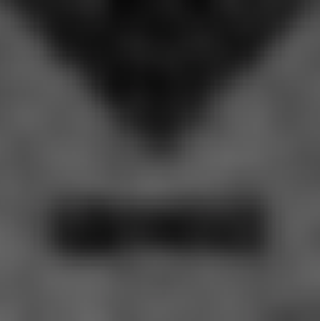

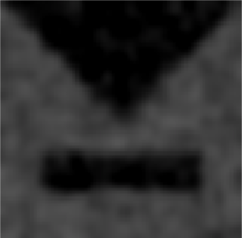
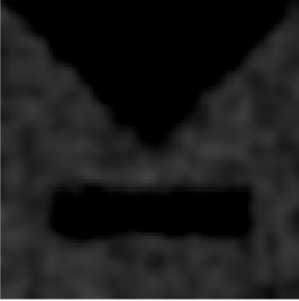
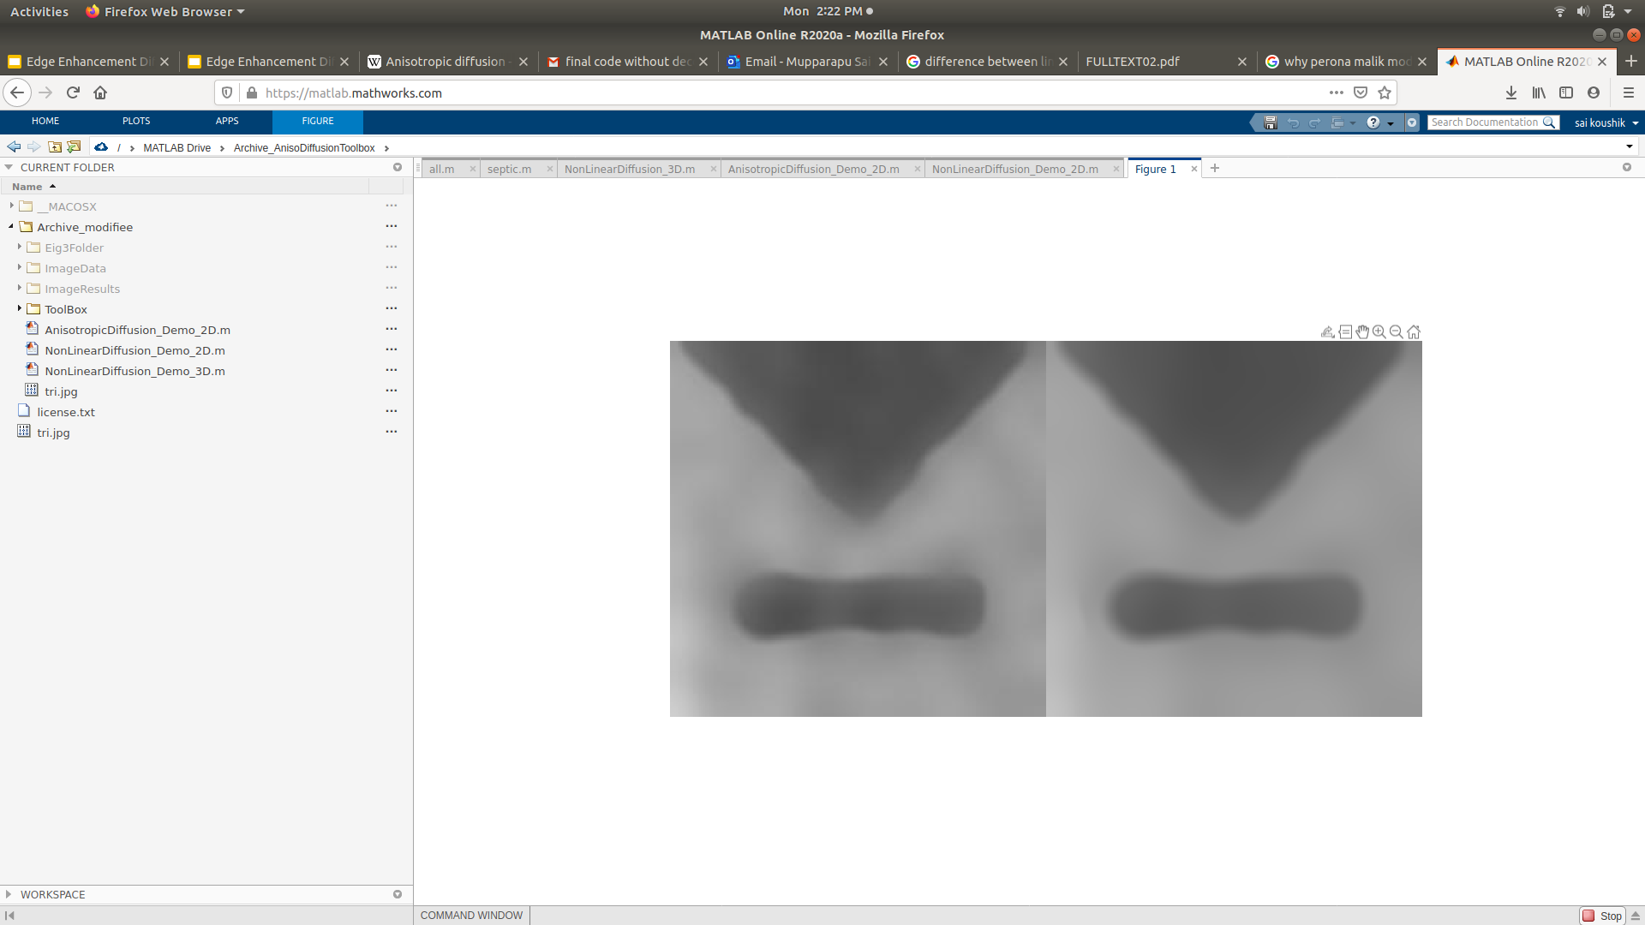
Results:

Slide 7

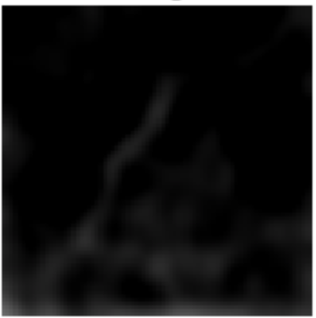

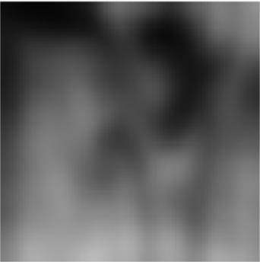

Slide 8
THANK YOU
Charupalli Charan (16XJ1A0549)
Medha Sahithi (17XJ1A0521)
Sai Koushik (17XJ1A0525)
Sai Sree Pokala (17XJ1A0569)
Satwik (17XJ1A0531)

